Slide 1
Gravity Guy
Akhilesh Ravi - 16110007

Slide 2
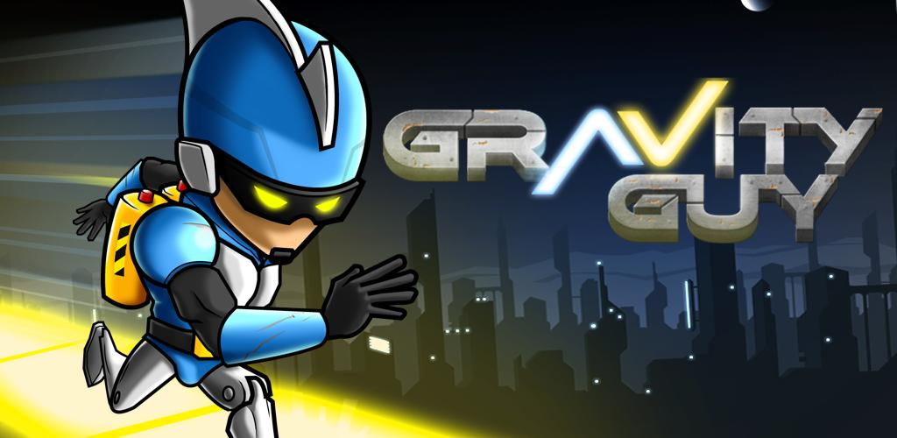

Slide 3
Gravity Guy
Gravity Guy is a 2010 side-scrolling endless runner/action/arcade video game developed and published by Miniclip. It was released on the App Store on December 8, 2010. - Wikipedia
Gravity Guy is a game in which you are running away from someone and you can change your gravity or the direction in which you are pulled by gravity.

Slide 4
Technical Features of my project
Object Oriented Programming
Inheritance
Usage of various functions and modules
Important module - pygame

Slide 5
Other Features
Loading Screen programmed using certain algorithms
Gravity filpping
Usage of graphics and images and animations
Score counter

Slide 6
Further Extensions
A level system or story mode
Multiplayer
Villains who attack you
Coin collection
Infinite Level

Slide 7
Loading Screen

Slide 8
Loading Screen

Slide 9
The Starting Screen

Slide 10
Gameplay

Slide 11
Gravity Guy Falling To Death

Slide 12
The Score Board

